Slide 1
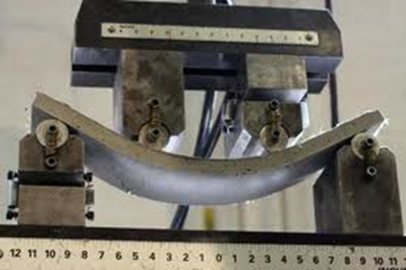
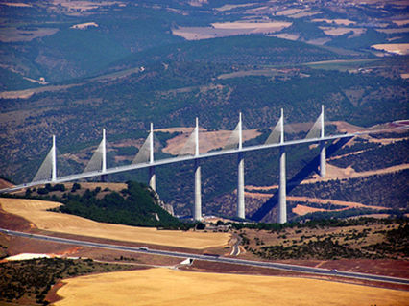
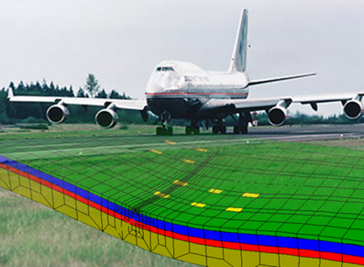
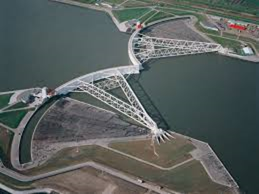
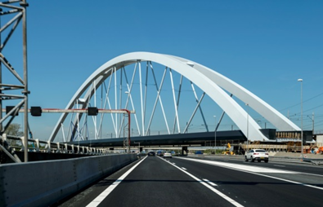
MSc track
Structural Engineering
Lambert Houben

Slide 2
MSc Structural Engineering
Structural (and functional) design, construction, management and maintenance of civil engineering structures, such as:
buildings, stations, stadiums
bridges, viaducts, tunnels
roads, railways, tramways
Basic sciences:
Structural mechanics, materials science

Slide 3
MSc Structural Engineering
Specialisation | Chair | Professor | Dpt.
Materials and Environment | Experimental Mechanics | Erik Schlangen | 3Md
 | Resources and Recycling | Peter Rem | ES
Structural Mechanics | Structural Mechanics for Buildings | Jan Rots | 3Md
 | Computational Mechanics of materials | Bert Sluys | 3Md
 | Dynamics of Structures | Andrei Metrikine | ES
Concrete Structures | Concrete Structures | Vacancy (Mladena Lukovic, Yuguang Yang) | ES
Steel, Timber and Composite Structures | Steel & Composite Structures | Milan Veljkovic | ES
 | Biobased Structures and Materials | Jan-Willem van de Kuilen | ES
Road and Railway Engineering | Road Engineering | Sandra Erkens | ES
 | Railway Engineering | Rolf Dollevoet | ES
Hydraulic Structures | Hydraulic Structures | Bas Jonkman | HE

Slide 4
MSc Structural Engineering
1st year MSc:
• WM0312CIE: Philosophy, Technology Assessment and Ethics for CT or
CIE4510: Climate Change: Science and Ethics or
WM1302TU: Ethics of Transportation or
WM0376TU: Ethics of Technological Risk or
TPM003A: Water Ethics
4 ECTS
• Compulsory courses for Structural
Engineering 32 ECTS
• Compulsory courses for specialisation 24 ECTS
60 ECTS

Slide 5
MSc Structural Engineering
2nd year MSc:
• in total 20 ECTS elective courses (at least 10 ECTS offered by Civil Engineering)*
or 20 ECTS
• ▪ CIE4040-09 Internship (10 ECTS) or
CIE4061-09 Multidisciplinary project (10 ECTS) or
CIE5050-09 Additional thesis project (10 ECTS)
▪ plus 10 ECTS elective courses*
• CIE5060-09 MSc thesis project 40 ECTS
60 ECTS
* Language and skills courses with WM-code not allowed

Slide 6
MSc Structural Engineering
Compulsory 8 variant-linked courses (32 ECTS):
CIE4145-09 (Dynamics and Introduction to Continuum Mechanics (4 ECTS)
compulsory elective course for most international students (intake))
If not done in BSc:
CTB3150/CTB3335 Concrete Structures 2 (4 ECTS) compulsory elective course
CTB3109-09/CTB3330 Structural Mechanics 4 (4 ECTS) advised elective course
CIE4100 CIE4110 CIE4115 CIE4121 CIE4140 CIE4160 CIE4180 CIE4190 | Material and Ecological Engineering Timber and Timber Structures 1 Steel Structures 2 Steel Structures 3 Dynamics of Structures Prestressed Concrete Plate Analysis, Theory and Application Analysis of Slender Structures | 4 4 4 4 4 4 4 4

Slide 7
MSc Structural Engineering
Compulsory courses for specialisation Structural Mechanics (24 ECTS):
Other courses:
CIE4353 Continuum Mechanics 6 ECTS
CIE5142 Computational Methods in Non-linear Solid Mechanics 3 ECTS
CIE5144 Stability of Structures 3 ECTS
CIE4130 CIE4143 CIE4150 CIE5123 CIE5145 CIE5148 | Probabilistic Design and Risk Management Shell Analysis, Theory and Application Plastic Analysis of Structures Introduction to the Finite Element Method Random Vibrations Computational Modelling of Structures | 4 4 4 4 4 4

Slide 8
MSc Structural Engineering
Compulsory courses for specialisation Materials and Environment (24 ECTS):
CIE4030 CIE5100 CIE5102 CIE5110 CIE5126 CIE5130 CIE5146 | Methodology for Scientific Research Repair and Maintenance of Construction Materials Capita Selecta Materials Engineering Concrete - Science & Technology Fatigue Capita Selecta Concrete Structures Micromechanics and Computational Modelling of Building Materials | 3 4 3 4 3 4 3

Slide 9
MSc Structural Engineering
Compulsory courses for specialisation Concrete Structures (24 ECTS):
CIE4170 CIE4281 CIE5110 CIE5127 CIE5130 CIE5148 | Construction Technology of Civil Engineering Structures Building Structures 2 Concrete - Science & Technology Concrete Bridges Capita Selecta Concrete Structures Computational Modelling of Structures | 4 4 4 4 4 4

Slide 10
MSc Structural Engineering
Compulsory courses for specialisation Steel, Timber and Composite Structures (24 ECTS):
CIE4125 CIE5122 CIE5124 CIE5125 CIE5126 CIE5128 CIE5131 | Structural Design – Case Study Steel, Timber or FRP Capita Selecta Steel and Aluminium Structures Timber and Timber Structures 2 Steel Bridges Fatigue Fibre-Reinforced Polymer (FRP) Structures Fire Safety Design | 3 4 4 4 3 3 3

Slide 11
MSc Structural Engineering
Compulsory courses for specialisation Road and Railway Engineering (24 ECTS):
CIE4860 CIE4870 CIE4880 CIE5850 CIE5871 | Structural Pavement Design Structural Design of Railway Track Road Paving Materials, Laboratory Experiments included Road Construction Capita Selecta Railway and Road Structures | 6 4 7 3 4

Slide 12
MSc Structural Engineering
Compulsory courses for specialisation Hydraulic Structures (24 ECTS):
* If not completed in BSC
** Not if CT3340 or CIE4345MI has been completed in BSc
CIE3310-09* CIE3330* CIE4130 CIE4170 CIE4310 CIE4345** | Open Channel Flow Hydraulic Structures 1 Probabilistic Design and Risk Management Construction Technology of Civil Engineering Structures Bed, Bank and Shoreline Protection River Engineering | 4 4 4 4 4 4

Slide 13
MSc Structural Engineering
Other courses in field of Hydraulic Engineering:
CIE4305 Coastal Dynamics 1 6 ECTS
CIE4325 Ocean Waves 6 ECTS
CIE5304 Waterpower Engineering 3 ECTS
CIE5310 Probabilistic Design in Hydraulic Engineering 3 ECTS
CIE5313 Hydraulic Structures 2 3 ECTS
CIE5314 Flood Defences 3 ECTS
Courses in field of Offshore Engineering:
OE4629 Load identification and monitoring of structures 4 ECTS
OE4680 Arctic Engineering 4 ECTS

Slide 14
MSc Structural Engineering
Other courses in field of Railway Engineering:
CIE4871 Design and Maintenance of Railway Vehicles 4 ECTS
CIE4873 Wheel-Rail Interface 4 ECTS
CIE4874 Elements of Railway Engineering 4 ECTS
CIE5826 Railway Operations and Control 4 ECTS
CIE5875 Railway Asset Management 4 ECTS
Of interest to all Structural Engineering students:
CIE4120 Information Systems for the
Construction Industry 4 ECTS
CIE4381 Engineering Asset Management 4 ECTS
CIE4481 Systems Engineering Management 4 ECTS

Slide 15
MSc Structural Engineering
Annotations:
Dynamics of Structures
Integral Design
and Management
Railway Systems
Specified set of courses
to choose as electives
Honours program
At least 20 ECTS extra in same time

Slide 16
MSc Structural Engineering
Apply for MSc track:
https://mystudyplanning.tudelft.nl/faculty/ceg
Announcements all education affairs in Brightspace.tudelft.nl “Master programme Civil Engineering and Geosciences”
Important links:
http://collegeramacolleges.tudelft.nl/new/ (on line lectures)
https://osistud.tudelft.nl/ (Osiris: progress and study results)
https://mytimetable.tudelft.nl/ (schedules)
https://studiegids.tudelft.nl/ (Study guide)
https:///www.tudelft.nl/en/student/faculties/ceg-student-portal/education/ (all other info)

Slide 17
MSc Structural Engineering
Information about MSc-study in following official document:
Teaching and Examination Regulations (TER) 2019-2020 Master Degree Programme CE & Master Degree Programme AES & 4TU Master Degree Programme CME
With Annex 2019-2020 Master of Science Civil Engineering
The Study Guide is a non-official document.
These documents can be found on the TU-website
At the latest around the start of the MSc thesis contact the graduation coordinator:
till July 1, 2020: L.J.M. Houben, lab. Stevin II room 2.27, (27)84917, l.j.m.houben@tudelft.nl

Slide 18
Employment
Mainly at:
Consultancy firms (general, specialized)
Contractors (specialized departments)
To limited extent at:
Government (‘Rijkswaterstaat’), Provinces, larger Municipalities (Amsterdam, Rotterdam, The Hague, Utrecht)
TUD (PhD projects)
Prospects are very good (for all civil engineers)

