Slide 1
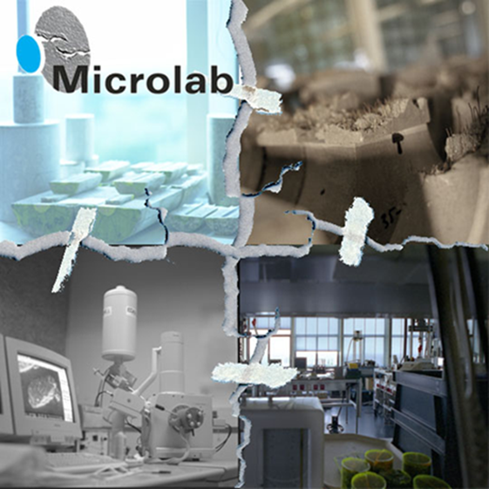
TU Delft Section Materials and Environment
Materials and environment
Chair: Erik Schlangen
Branko Šavija

Slide 2
Societal relevance
Ageing infrastructure
Environmental impact

Slide 3
Courses
CIE5110
Concrete – Science and Technology
CIE5100
Repair and maintenance of construction materials
CIE4100
Materials and Ecological Engineering
CIE5102
Forensic building materials engineering
CIE5146
Micromechanics and computational modelling of building materials

Slide 4
Materials & Environment; material cycle
Concrete Modelling & Material Behaviour
Experimental Micromechanics
Durability
Sustainability
MICROLAB

Slide 5
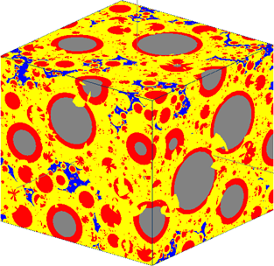
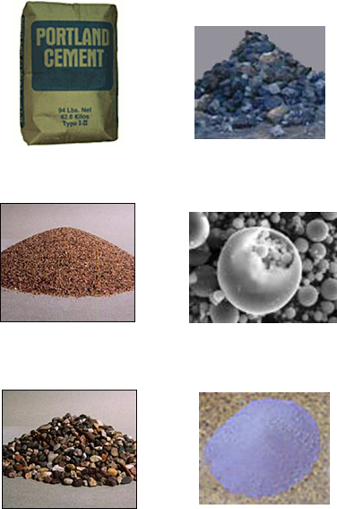
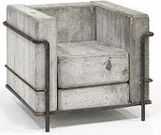
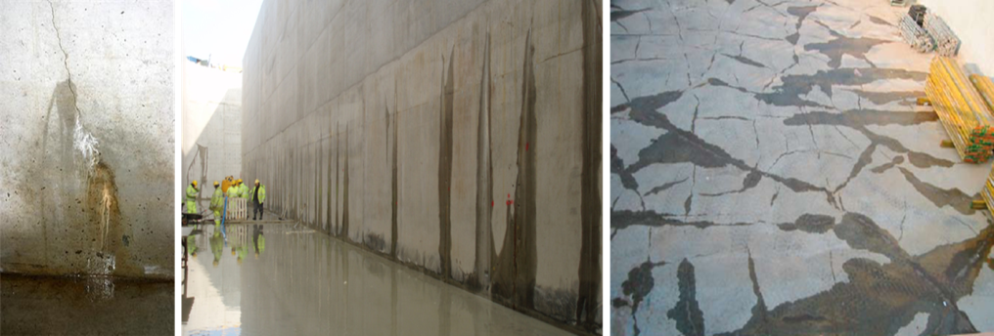
Focus of the group “Concrete Modelling & Material Behaviour”
Concrete Mix Design
Early Age Concrete Properties
Cement Chemistry
Cement Hydration Modelling (Hymostruc)
Alternative binders
Alkali Activated materials; Geopolymers
Ageing of materials (& structures)
Concrete Modelling & Material Behaviour
Guang Ye

Slide 6
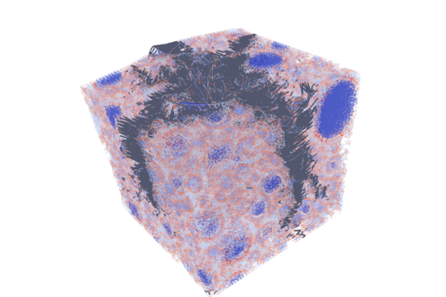
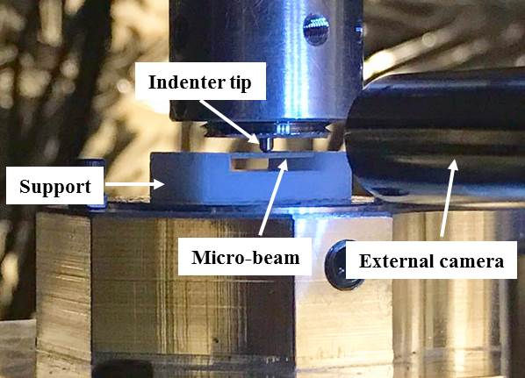
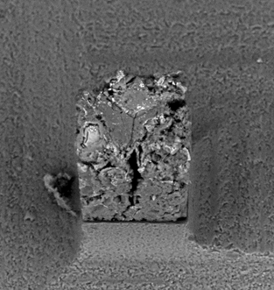
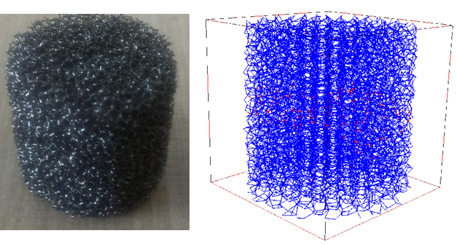
Focus of the group “Experimental Micromechanics”
Development of experimental techniques
Lattice fracture model
Self healing materials (concrete & asphalt)
Modelling of durability & healing
Self Sensing materials
Additive manufacturing (3D printing)
Experimental Micromechanics
Erik Schlangen
Branko Šavija

Slide 7
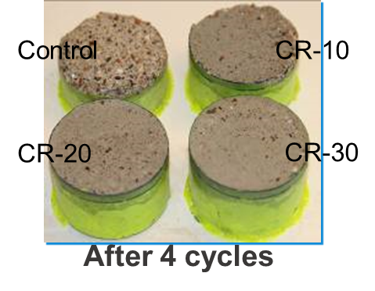
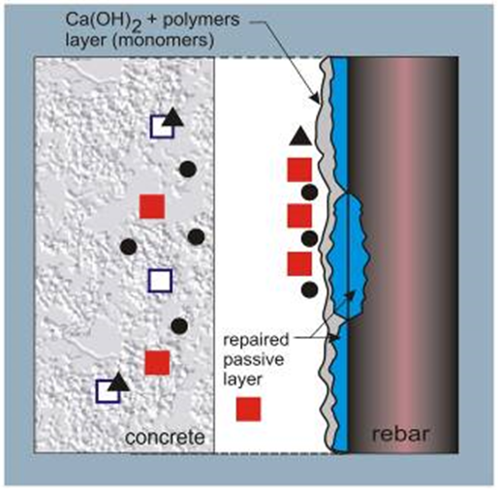
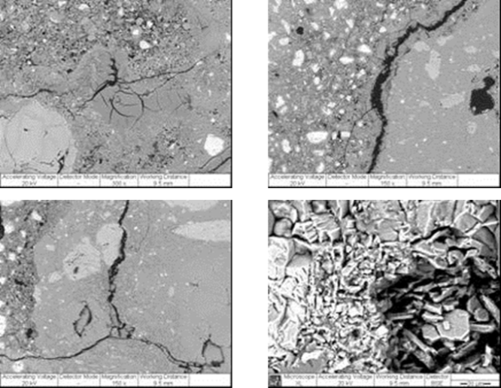
Focus of the group “Durability”
Durability of materials
Forensic Material Engineering
Corrosion of Concrete Reinforcement
Alkali Silica Reactions
Methodologies for durable maintenance
Repair strategies.
Durability
Oguzhan Copuroglu
Dessi Koleva

Slide 8
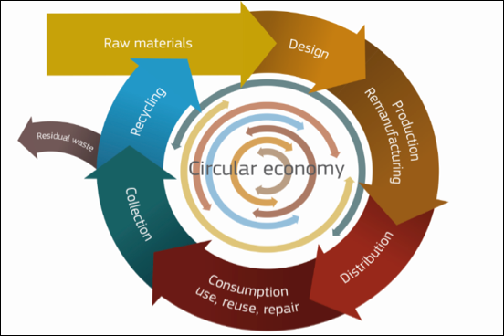
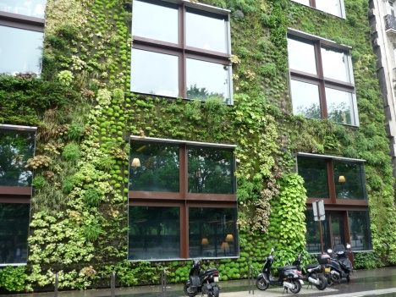
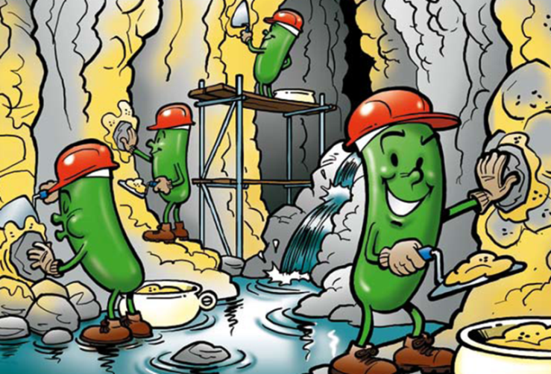
Focus of the group “Sustainability”
Green Materials
Green Environment
Smart Cities
Life Cycle Analyses
Bio-based Material Development
Bacterial Self-Healing Concrete
Circular Economy
Sustainability
Henk Jonkers
Marc Ottele

Slide 9
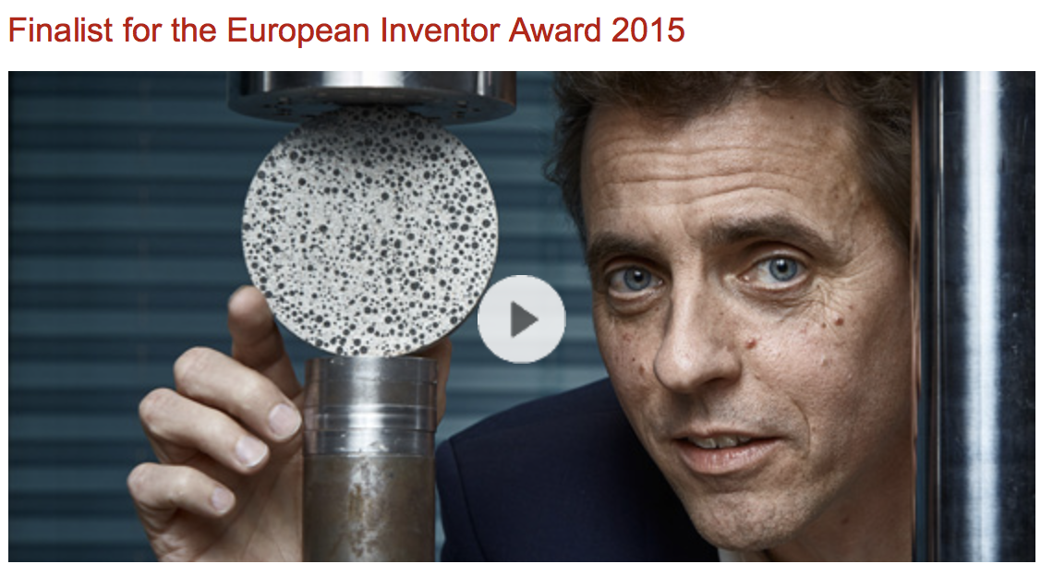
Societal impact

Slide 10
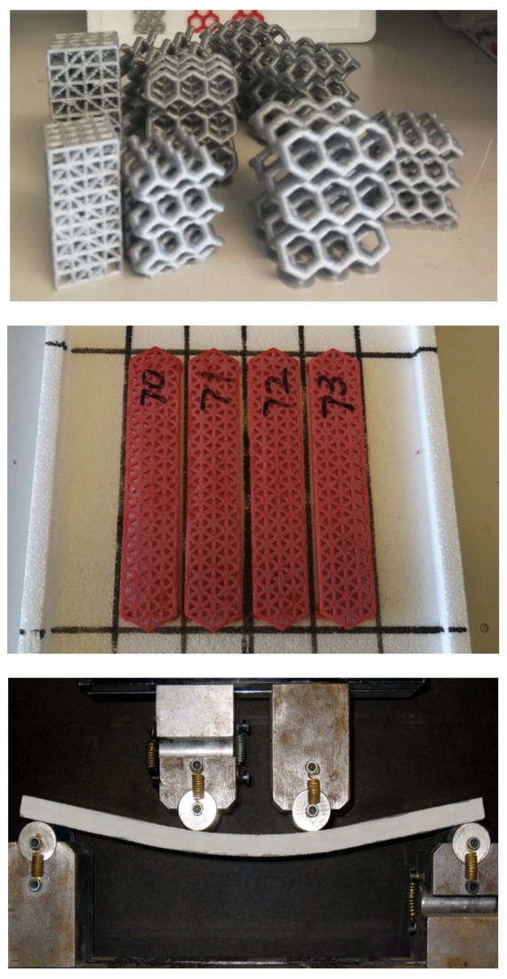
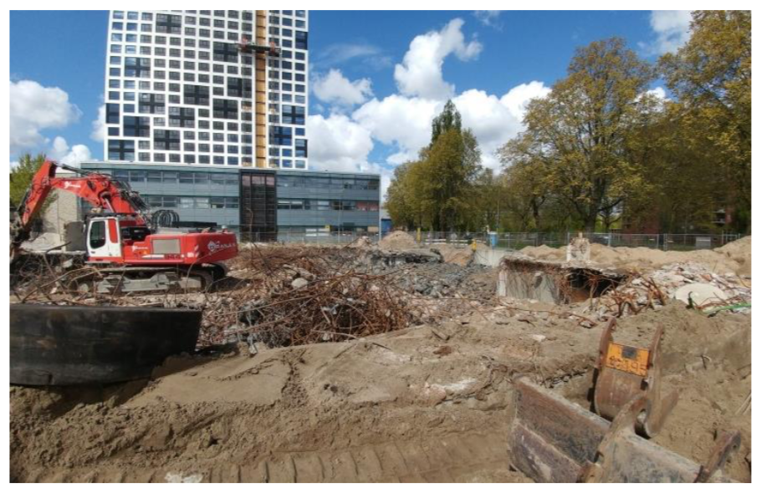
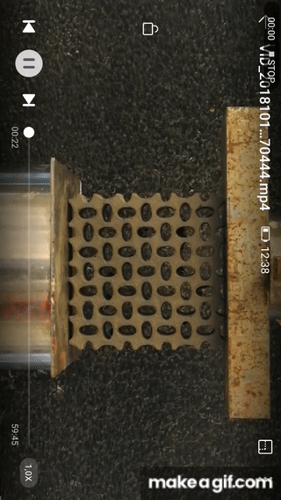
MSc thesis project examples
and many more…

Slide 11
Where?
b.savija@tudelft.nl
Office 6.02

