Slide 1
Technology for Circularity
Concrete structures
Resources & Recycling,
Faculty of Civil Engineering and Geosciences

Slide 2

Concrete structures
Resources & Recycling
How can we ensure a sustainable survival for human beings on Earth in the near and far future?
Notes:
It is not “to be or not to be”, This is the question!

Slide 3
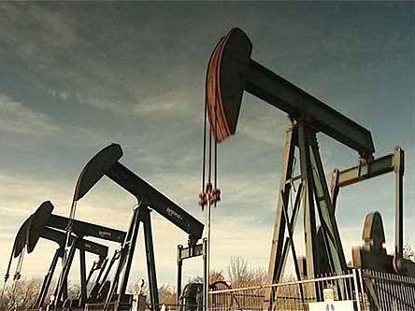
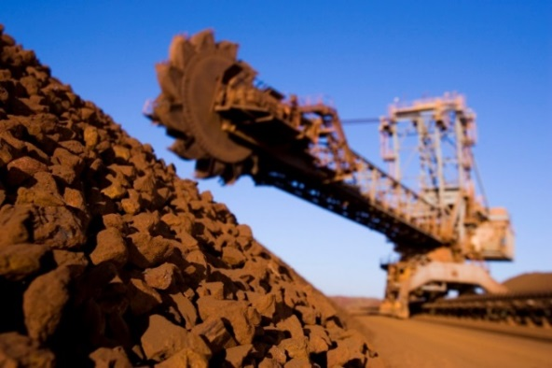
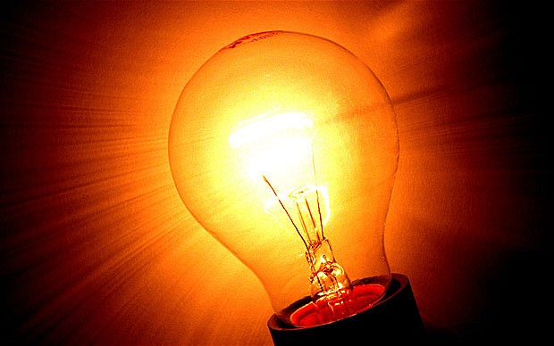
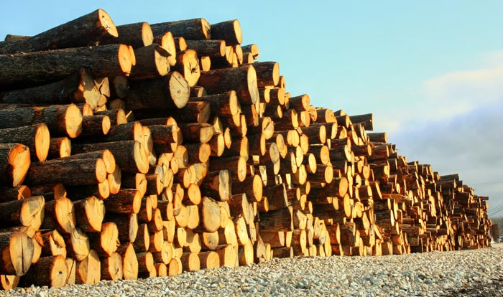


Concrete structures
Resource Efficiency & Sustainability
Considering the depletion of raw materials, energy, water, food, a big societal challenge is how to improve the efficiency of consumption (e.g. the recycling rate) while reducing waste
Notes:
Along with technology innovation, we are developing a new methodology to measure resource efficiency/sustainability.
We do believe that the details of this methodology will define to a great extent both the direction in which the European Economy will change (as result of this new policy) as well as the speed and economic efficiency of this change.
What are non-sustainable/stressed resources (is water non-sustainable? Water in NL is different than water in Saudi Arabia)? Why are they stressed? How do we measure them?
Mass based indicators can be misleading… What does it mean that each European use 13 t of resources?
How do we measure energy?
Our formula provides a dimensionless indicator that measure all resources!

Slide 4
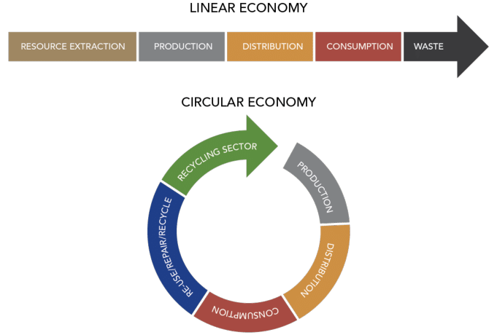
Concrete structures
Resources & Recycling
Graphic representations of Linear Economy vs Circular Economy (Christian Voigt)
Notes:
Despite it may seem simple to be done, actually it is not. Because wastes are usually complex mixtures. For instance this is how plastic waste looks like…
However at R&R we have succeeded to develop innovative technologies to make this to happen (from linear to circular). E.g. MDS

Slide 5
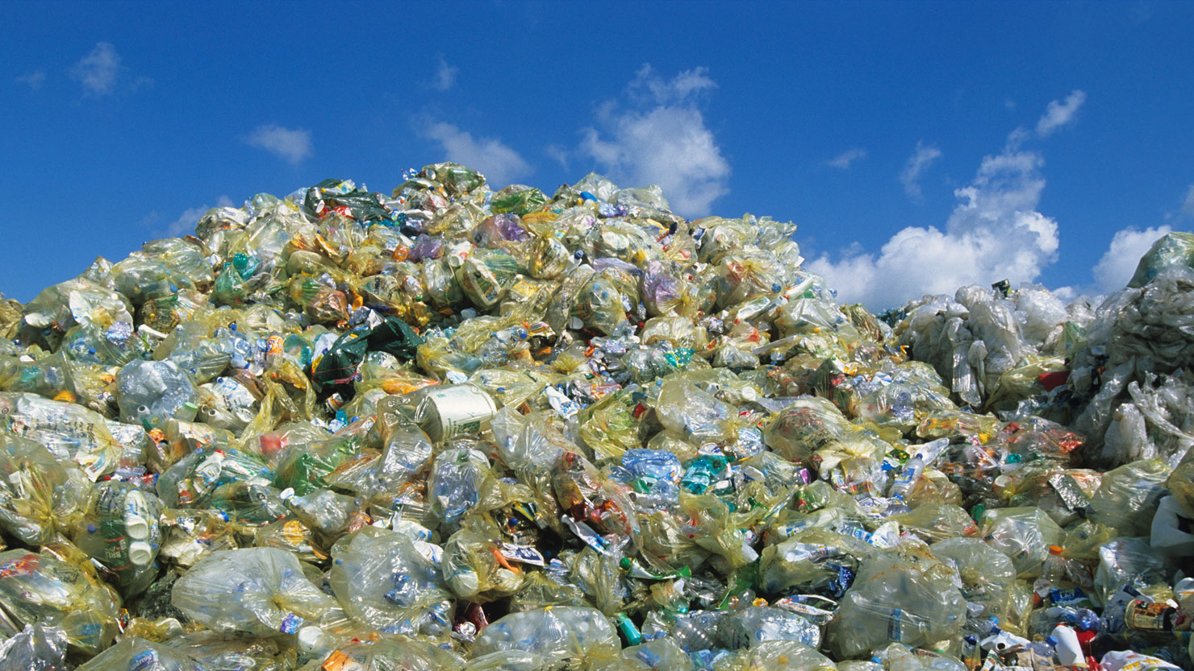
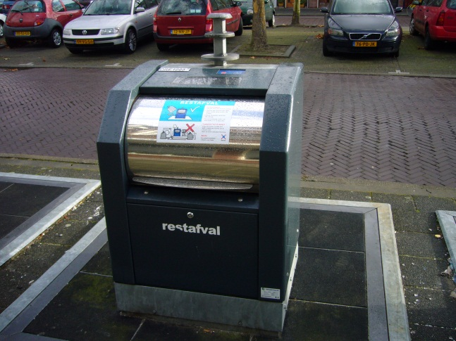
Mixed plastics waste: this is what it looks like …

Slide 6


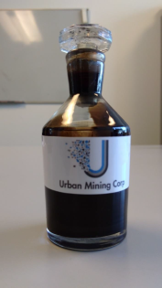
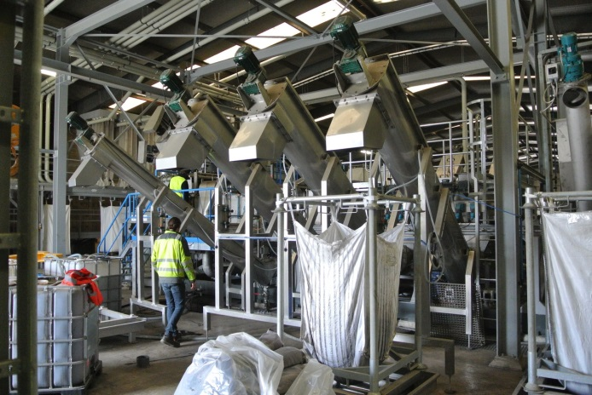
Concrete structures
Sorting into many at low cost
UMC
~ 12 employees
FP 7 (EU): 1 Meuro
Perspective (NWO)
1.1 Meuro (CiTG)
Share value today:
1.2 Meuro (CiTG)
Packaging plastics
Aim: 500 € of PP, PE, PET per ton

Slide 7
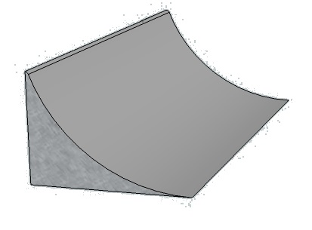
High Definition Sensor Sorting
Concrete structures
·
Schematic diagram of logarithmic sorting

Slide 8
High Definition Sensor Sorting
Concrete structures
·
Schematic diagram of logarithmic sorting

Slide 9
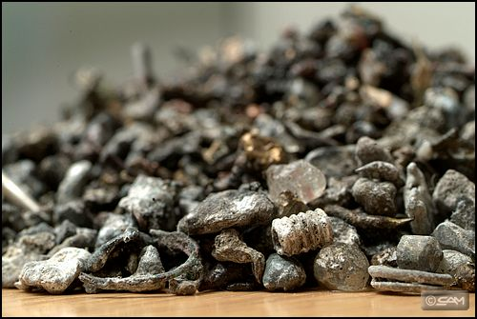
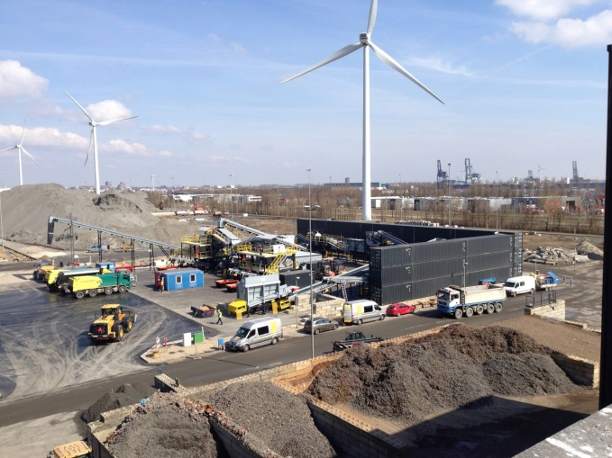
Concrete structures
Sorting metals from moist fine wastes
Inashco
~ 300 employees Europe, US, Asia
Fondel: 1.4 Meuro upfront (2009)
Inashco: 0.8 Meuro
(2013-2018)
Shares sold (2015/7):
1.2 Meuro (CiTG)
Ashes from household waste
Aim: 20-30 € /ton ash of copper, gold, silver, zinc, lead, tin

Slide 10
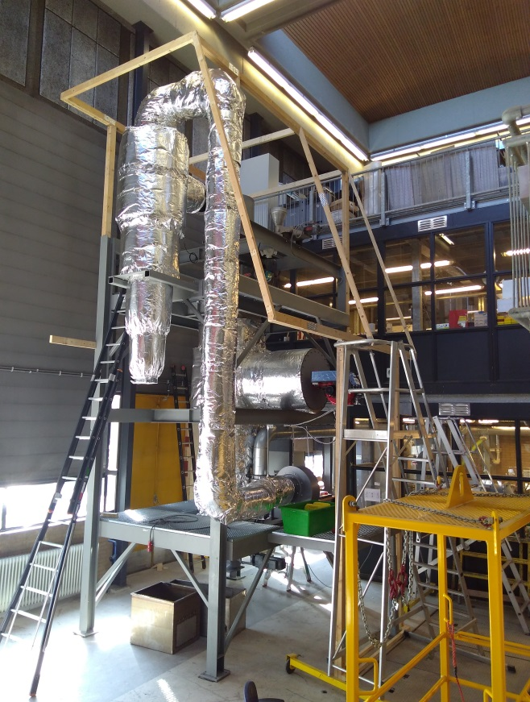
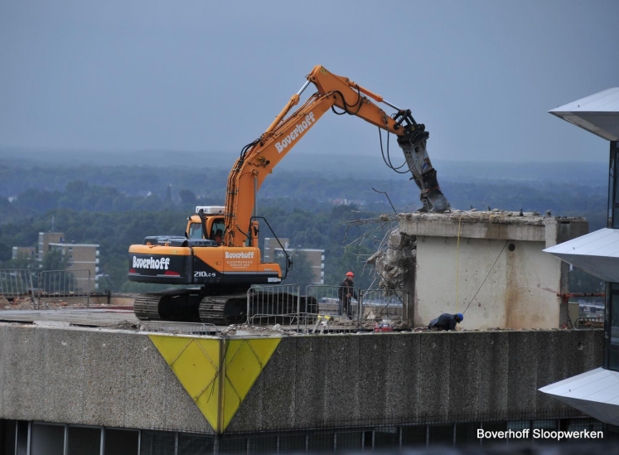

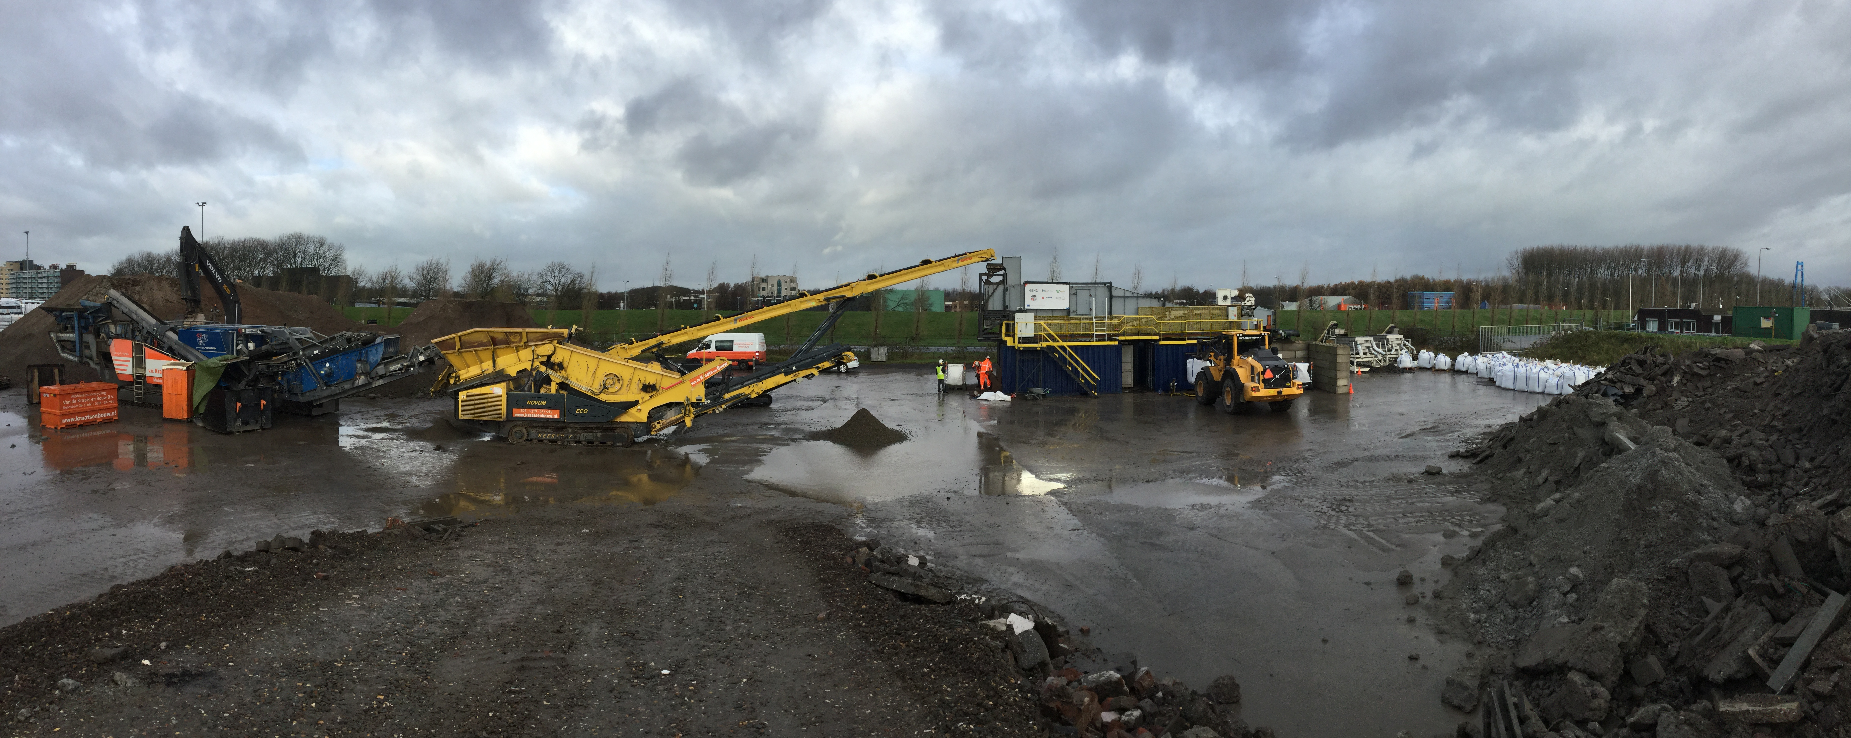
Concrete to gravel, sand, cement
Concrete structures
C2CA
1 employee
FP 7, Horizon (3X)
3 Meuro (CiTG)
Share value today:
1-2 Meuro (CiTG)
EOL buildings
Aim: 20 € of gravel, sand, cement per ton
We are collaborating with Strukton, Volker Wessels, BAM, Oranje, etc.
Notes:
They all want to know how to reuse secondary (recycled) resources from buildings to build new buildings.

Slide 11
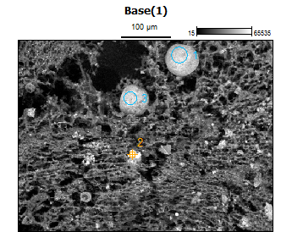
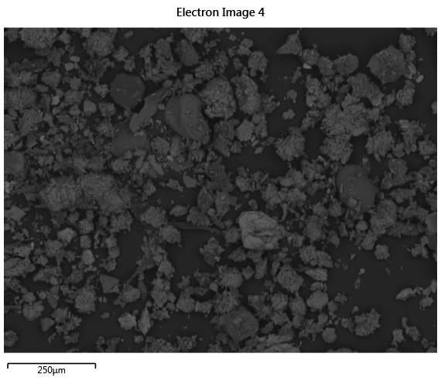
Phosphate
Concrete structures
Prototype at sludge processing plant
Phosphate
TUD/Wetsus
60/40 patent
Commercial value
unknown

Slide 12
Concrete structures
Circularity: how to measure it?
Circularity is a tool:
net market value of all recycled materials from a product (€)
------------------------------------------------------------------------------------
market value of the input materials for producing the product (€)

Slide 13
Resources & Recycling
Concrete structures
Resource efficiency and circularity is an interdisciplinary subject which includes several disciplines (e.g. Process Engineering, Economics, Material Science, Structure Engineering, Social Sciences, Data Analysis, Industrial ecology, Policy, etc.)
If you make your thesis at R&R, you will be dealing with laboratory activities, experiments (also in real industrial facilities) as well as with other analytical and desk work.
Yuri found out that it is possible to recognize which brand/application a packaging plastic originates from.
Stef found out what conditions are necessary for phosphate to be recovered from digested sewage sludge.
Kozmo is developing a blockchain-like tool to monitor recycled material along the value chain.
We do have a recycling plant in Hoorn.
Notes:
Along with technology innovation, we are developing a new methodology to measure resource efficiency/sustainability.

Slide 14
Concrete structures
The innovations to ensure sustainability are coming!
Thank you!
Francesco Di Maio
f.dimaio@tudelft.nl

